Slide 1

INVESTOR
PRESENTATION

Slide 2

Introduction
Table Of Contents
3
Objectives
4
Mission Statement
Vision Statement
5
5
Hybrid Business Model- a synergistic approach
Product and Services
Welltopia Apps
6
7- 10
11-12
13- 16
17
Market Analysis
Marketing Plan and Strategies
SWOT Analysis
18
Intellectual Properties
The Team
19
20
Potential Competitors and Our Edge
Financials
21
22-23
24
DCF Valuation
Valuation and The Ask
Milestones to be Achieved
Exit Strategy
25
26
27
Contact Info
28

Slide 3

3
Introduction
A steady and faster rise in the ageing population and increase in
costly healthcare needs for chronic diseases are exerting
considerable demands on the healthcare systems in India. This
demand is only partly met with, despite best efforts from private
and public healthcare’s endeavors.
India’s healthcare sector is currently the second fastest growing in
the country surpassed only by retail. Unsurprisingly, many
corporate houses are looking to exploit the opportunities this field
of business provides and are actively considering diversification
into or have already diversified into this sector by setting up their
own healthcare facilities.
In order to meet India's burgeoning healthcare needs and leverage
on the opportunities available, the founder has launched a
company named “Welltopia” - The premium healthcare and life
enhancement center in 2019. The company provides gamut of
services that improves and enhances quality of human lives. The
Company is managed by the CEO, Dr Uttkarsh G, a strategic leader
and innovator.Qualified doctors and assistants are there along with
administrative staff to assist him in daily operations. The staff is
provided training at reasonable intervals to update them with the
latest medical technology and best medical practices prevailing in
the industry.

Slide 4

4
Objectives
• To focus on niche areas such as Lifestyle Diseases, Weight
Management (~50% of population in metro cities are
overweight/obese) Anti-aging Treatment (~20% of
population in India will be over 50 year of age by 2030),
thus creating a futuristic medical institution
• To make available in Delhi NCR a modern, well-equipped
and efficient health care facilities that will provide a much
higher standard of patient care than any other medical
facility in the metro
• To increase the range of services wherever there are
opportunities to meet an area of patient need and demand,
on financially viable basis
• Thus, to provide holistic healthcare to achieve wholesome
health and enhance the quality of human lives

Slide 5

Mission Statement
Vision Statement
5
The mission of Welltopia is to provide
holistic care to achieve wholesome
health at its centers across the country. It
aims to improve the quality of life of
members of community by offering them
high quality patient-focused health care
options at affordable pricing.
Wellness or Health is not absence of any
infirmity or absence of illness; it’s rather
presence of total mental, spiritual and
physical well-being. With this thought in our
mind we have created Welltopia. We aim to
provide “holistic care to achieve wholesome
health”.
We also understand this is not possible
without the aid of the technology, hence,
we are pushing towards digitization of
our services via our Apps
Key Success Factors
Niche medical services such as consultation on Lifestyle Diseases, Anti-aging treatment,
under one roof – “we are only institution in India to do so”
Experience of the founders/leaders
Strong marketing strategies
Hybrid Business Model creating synergies in operations

Slide 6

Hybrid Business Model- a synergistic approach
6
Online – SaaS
Offline – Clinics & OPD
Welltopia has been developing two Apps for the
Patients:
• Welltopia already has an established OPD at Sec 52
NOIDA and plans to set up five more in next three
years
A. FEDA App: with the inbuilt algorithm, the patients
get their fitness programme (consisting of medical
Prescription, Diet Chart and Exercise Programme) in
<100 seconds, delivered on their mobile and Email
•
Revenue from one OPD is ~50 Lacs INR in latest FY
and it’s in Black currently
•
Expected annual revenue from six OPDs by FY25 is
INR3.9 Crore and by FY27 it’s expected to be
INR6.3 Crore
B. Digital OPD App: This app too makes diagnosis by
an inbuilt algorithm and deliver the medical
prescription <100 seconds
With focused and intense promotion of the Apps, we
expect to reach one lac downloads in 18 months and
five lacs downloads in three years
Synergy is expected between two
arms of the business – as we have
more and more downloads of our
Apps, the users are likely to reach
us at our OPDs as well, when they
need to see a doctor in person
With five lacs downloads we’d expect at least 10-
15,000 active users per month who’d use our services
at the Apps, this would generate online revenue and
increase the offline patients inflow as well – the
synergy

Slide 7

7
Products and Services
We are living in a world where we eat junk foods and don’t take much physical exercise. We tend to put on too much weight that is
progenitor of Lifestyle Diseases.
Aging is a natural phenomenon but in this ultra-polluted world coupled with extreme stress, one gets old earlier than one should. All
these problems are solved by the company, Welltopia that has been providing services in the healthcare segment since its inception
in 2019.
There will be six main services to be provided by Welltopia which are outlined as follows:
Services Offered by Welltopia -
LIFESTYLE RELATED PROBLEMS:
Lifestyle diseases result due to lack of physical activity and unhealthy
diet. Lifestyle diseases are significantly affecting the younger
population. One of the biggest lifestyle diseases that are seen
commonly in India is obesity. This normally happens when people
burn lesser calories than they consume. It’s usually result of excessive
eating coupled with lack of exercise. The doctors and the dieticians at
company help people overcome this problem through managing their
diet and suggesting ways to improve their overall health score.
Management of Obesity/Excess weight
Management of low weight
Management of COPD (a lung disease)
Management of Hypertension
Management of Diabetes
Differentiating Features: To manage weight we evaluate the overall
health including the blood profile and hormone assays before
prescribing drugs such as Lipocut and other weight loss drugs.
In case of any hormonal abnormality that too is addressed, so we
provide a wholesome cure to obesity and associated morbidities

Slide 8
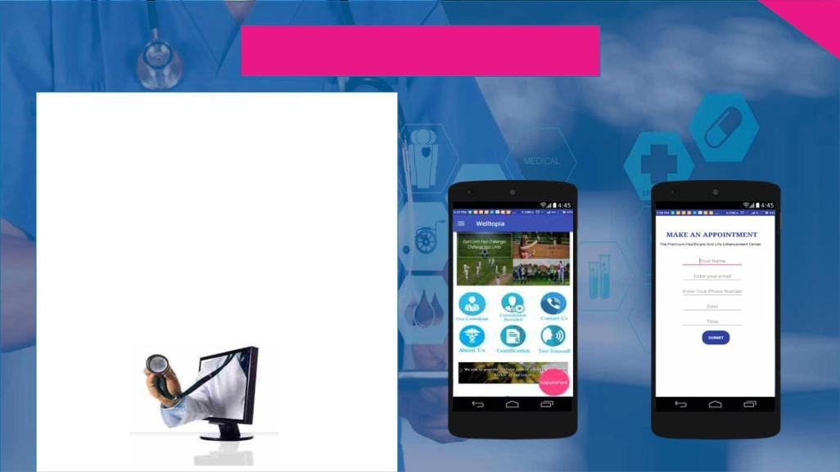
8
Products and
Services
TELEMEDICINE:
For decades, telemedicine has been used to bring
healthcare services to patients in distant locations.
Telemedicine improves access to patients and allows
physicians and health facilities to expand their reach,
beyond distances. The mobile apps designed by the
company for Tele-medicine has potential to create an
interconnect framework that connects doctors,
patients remotely over Internet eliminating the
computing complexity to backend systems thereby
reducing cost at client end. The Secure access to
patient medical data from anywhere enables remote
consultation and second opinion easier.

Slide 9

9
Products and Services
ANTI AGING TREATMENT:
The services provided under this segment are outlined as follows:
The difference we make to Anti-ageing
Treatment: the Company don’t provide just skin
treatments as Anti-aging treatment. It
understands that Skin is just a cover to the
human body. Age impacts each individual at
every level including muscle, bones, lungs and
cardiovascular health and mental agility.
Reduction/lightening of wrinkles – this where current anti-aging
treatments stop
Antioxidant Therapy
Building Bone Density
We focus on health of vital organs such as Heart,
Lung, Kidney and Brain and that begins with
impeccable blood health.
Skin: Specialized and customized plans are
prepared depending upon each skin type and
concerns. The expert dermatologists at the
company carry out a thorough skin analysis to
understand the lifestyle and accordingly diagnose
the reasons and signs of ageing.
New age
anti-aging
treatment
Building Lung Capacity
Building Adequate Muscle Strength
Building Adequate Cardiovascular Stamina
• Maintaining Adequate Mental Agility
To take care of the skin’s need, the company has created Youth-Back emulsion treatment plan which consists of various pharmaceutical and
natural substances which includes Vitamin C, B and H. The product enhances collagen production, reduces sebum production, fights bacteria at

Slide 10

10
Products and Services
PSYCHOLOGICAL AID :
With the rise of various working sectors and
competitive thinking, psychological stress and
anomalies are rising at the fast pace. The rate of
various mental disorders in India shows a drastic
growth, which makes it a matter of concern. If
someone looking for the best psychologist in Noida
or Delhi NCR, then Welltopia is providing support.
The team of Welltopia is consisting experts who
understands every up and down that every human
face in his life and can help to tackle it. With the
sheer dedication, Welltopia has cured the people
with most vulnerable disorders such as bipolar
disorder, depression, anxiety.
The services provided under this segment are outlined as
follows:
Dialectical Behavior Therapy (DBT)
Cognitive Behavioral Therapy (CBT)
Psychoanalysis
Counseling
Medications
Psychological help is not only meant to provide medications to the patient. It involves various steps and a lot of patience. We work in discrete
steps to get our patient to better mental and psychological health.
We hope to create happier and stress free, healthy people who can contribute positively towards their families and society they belong to.

Slide 11

11
Welltopia Apps - Introduction
The App has three components – Fitness, Diet &
Key Features of the FEDA App -
exercise and Anti-ageing
Key Features of the Digiital OPD App –
• Fitness component focuses on weight management
• Diet & Exercise Component provides various diets
to target different needs such as - Anti-ageing diet,
Anti-pollution diet, Immunotopic diet (i.e.
immunity boosting diet), Neurotopic diet (i.e. brain
boosting diet) and Weight Loss diet
The App diagnose the ailment and deliver the
prescription in <100 seconds to the patients at <100
Rupees. The app is also called the “Two Minutes
Doctor”TM ; the app also gives opportunity to the
patients to chat with the doctors and resolve their
queries.
• Anti-aging component focuses on providing anti-
aging solutions that goes beyond wrinkle removals
and work on Muscle/Bone health and strengthen
heart and lungs, which are key to healthy living
The salient feature of the App is that – it can
differentiate between a medical emergency and a non
threatening disease and alert the patient if she’s
suffering from a medical emergency. Thus the app will
ensure that no human life is lost and people are
served adequately, efficiently and skillfully.
Both the Apps will also be made available
in Hindi (in 2023) to target Hindi speaking
and rural population of India

Slide 12

12
Welltopia Apps – Problems Solved by the Apps
FEDA App– The App has three components – Fitness, Diet
and Anti-ageing
Digital OPD App – The App diagnose the ailment and
deliver the prescription in <100 seconds to the
patients at <100 Rupees, all in comfort of the home.
• Fitness, Exercise, Diet and Anti-aging treatment all at one
place.
Fitness
Anti-
aging
Thus, the app eliminates the need of going to a
doctor’s clinic (saving time and effort of a sick
patient who needs to rest), all this done in <100
seconds and <100 INR – extremely cost and time
effective
Both Apps excel at
being exceptionally
cost and time-
effective, besides
being solution-centric
Diet &
Exercise
By offering these two
Apps we are helping in
reducing Carbon
• Fitness, Diet and Anti-aging are interdependent and the
diet & exercise are at the root of the triangle affecting
both fitness and aging process
• We are the first institution to realize this interconnection
and provide solution of all three via one app
Footprint of our
healthcare and reduce
the use of papers, thus
saving trees as well

Slide 13
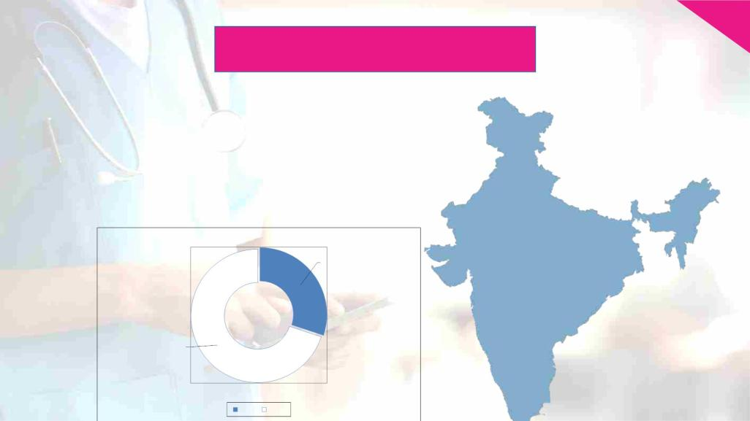
13
Market Analysis
Healthcare has become one of India’s largest sectors - both in terms of
revenue and employment. The Indian healthcare sector is growing at a
brisk pace due to its strengthening coverage, services and increasing
expenditure by public as well private players. India's competitive advantage
lies in its large pool of well-trained medical professionals. India is also cost
competitive compared to its peers in Asia and Western countries.
India have also become one of the leading destinations for high-end
diagnostic services with tremendous capital investment for advanced
diagnostic facilities, thus catering to a greater proportion of population.
Healthcare Industry In India –
$160 Billions
$372 Billions
2017
2022

Slide 14

Market Analysis
14
Life style related diseases in India –
According to a latest report, one in three or 33% of Indians over 35 years
of age are suffering from one or more lifestyle diseases such as diabetes,
high cholesterol, blood pressure, thyroid disorders and obesity.
Prevalence: Nearly 16% of people in India are suffering from
Hypertension, followed by 9.4% people are suffering from high
cholesterol, 6% suffering from diabetes and 6.7% suffering from thyroid
disorders. Over the years, there has been an increase in the number of
chronic diseases due to the disruptive lifestyle changes in the country.

Slide 15

15
Market Analysis
Tele –Medicine Market In India –
Industry Size USD Million
40
Telemedicine is one of the fast emerging segments of health
care sector that are gaining massive attention for its extensive
growth and usage. Telemedicine has helped in increasing access
to affordable healthcare and provide emergency and intensive
care services with the aid of specialized professionals from
urban areas. It has also helped in early diagnosis and treatment
which has further enhanced health outcomes. Tele-Med is
expected to grow @ 30% p.a. between 2022-27.
30
20
10
0
2018
2020

Slide 16
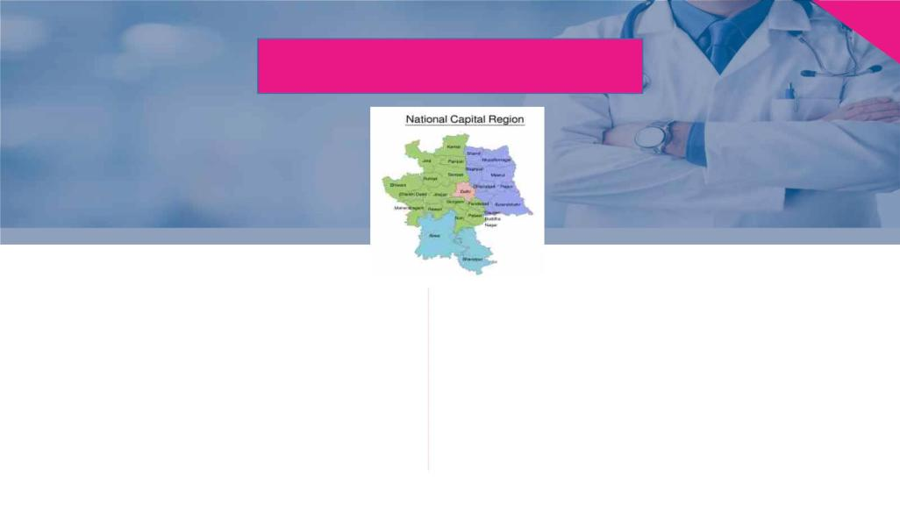
16
Market Analysis
Anti – Aging Treatment In India –
Healthcare Facilities In Delhi -
Indian Anti-Aging industry has reported a tremendous
growth in the recent years, and is presenting ample
opportunities to the industry players. With favourable
demographics and rising awareness, Indian Anti-Aging
market is poised to scale newer acmes.
There has been a steady decline in number of health care
infrastructure crucial for first level of intervention in Delhi. Number
of primary health centers has remained stagnant at 8. This is despite
the fact that the State’s population has been increasing at the rate of
10% every five years. Even more surprising is the fact that the
number of dispensaries in the state reduced by 17% in just one year:
from 1,507 in 2015 to 1,240 in 2016. It is worth noting that although
the number of nursing homes has almost doubled from 607 to 1,057
between 2007 and 2016, number of hospitals dwindled from 94 in
2012 to 83 in 2016. The immediate fallout of this is that the
hospitals in Delhi are facing heavy patient load.
Globally it is around $600 billion business in the world and
even in India there is around 41,000 Crore business of these
anti-ageing and cosmetic products. India is now a hub for
medical tourism in anti-aging.

Slide 17

17
Marketing Plan & Strategies
Our Objective
Target Customer
•
•
•
Increase the patients traffic to the website and our Apps
The targeted customer segments of the company
are people aged 20 to 75 years suffering from
obesity, diabetes, hypertension, mental conditions
or age-related issues.
Introducing and promoting the concept of Tele-medicine
Increase the visibility of company’s brand on Google and other search
engines and various platforms of the social media
Bring referrals from patients and other healthcare organizations
Provide quality consultancy services and assist people in maintaining
their health
•
•
Marketing Calendar –
Measurements –
Modes Of Marketing –
Welltopia has set up a marketing calendar
that is updated at regular intervals. The
calendar assists the marketing officer in
measuring the results of marketing
strategies, in order to improve the same
and add some more tools to the marketing
plan of the company.
Welltopia measures the
results of marketing plan
with the objectives that have
been created earlier to make
sure that the plan goes as
planned.
•
•
•
•
•
Social Media
Referrals
Website
E mails
Search Engine Optimization (SEO)

Slide 18

18
SWOT Analysis
Strength
S
W
Weakness
• Highly Skilled Team
• Experience and Qualification of Management
• Strong Marketing Strategies
• Already Established Network of Patients
• Diversified Niche Services
• Relatively new business with brand needs to be
strengthened further
• Foray into Telemedicine where competition is
lesser and growth is higher and there is
opportunity for synergies
Opportunity
O
Threat
T
•
•
Shortage of Doctors in Most Parts of India
Huge Demand Supply Gap esp. in area of
Tele-medicine
•
Competition in Wellness and Lifestyle
Services by Strong Brands such as VLCC
• Prolific Competition by Small Timer Weight
Loss Experts
•
•
Tie up with Corporates
Growing market for Lifestyle Diseases and
•
Low Penetration of Healthcare Insurance in
India
Anti-aging treatment

Slide 19

19
Intellectual Properties
Intellectual properties are crown jewel and heart of the company in terms of differentiating strategy and revenue generation.
Welltopia has created one IP so far
Youth-BackTM – The Anti-wrinkle and Anti-acne Solution
•
•
We have created Youth-back emulsion consisting Vitamin B, C, H
and various natural and pharmaceutical agents
The solution act by reducing sebum production, thus
fighting bacteria/acne
•
•
•
It increases cell turnover in skin thus exfoliate smoothly without the need of chemical peeling
It increases collagen production thus enhances elasticity of skin naturally
To
know
more
on
Anti-aging
treatment
and
Youth-back
emulsion
please
go
to
https://www.youtube.com/watch?v=eXq3d14EAwo
More information on Intellectual Properties of Welltopia is available at
https://www.welltopia.pro/intellectual-properties/

Slide 20
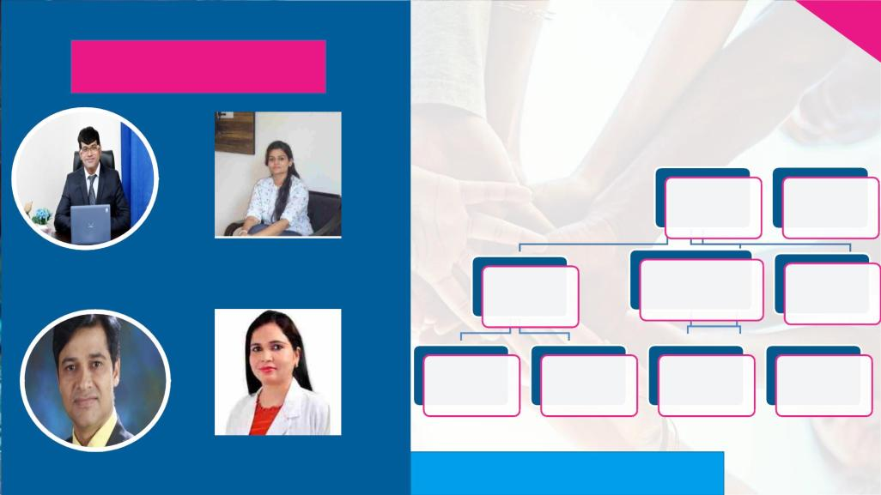
20
The Team
Our Team Hierarchy
Executive
CEO
Director
https://www.welltopia.pro/our-consultants/
Dr. Uttkarsh G
(CEO)
Dr. Mitsuvi Malik
(Psychologist)
Administrative
Doctors and
Consultants
Marketing
Officer
Staff
Allied Health
Professionals
Assistants
Billing Staff
Receptionist
Dr. Sanjeev Lavania
(Executive Director)
Dr. Namita Nadar
(Dietician)
https://www.welltopia.pro/our-consultants/

Slide 21

21
Potential Competitors
Our Edge over the Competitor
Our Edge
• First and foremost our cost is barely 10% of VLCC’s
• Second, Welltopia provides a comprehensive solution to the
Obesity/Weight Management problem
• VLCC doesn’t treat comorbidities such Diabetes, Hypertension;
additionally a root cause of diagnosis (checking hormonal
imbalance) isn’t made at VLCC
• Welltopia fills all three of these gaps in VLCC’s services
Our Edge
• Welltopia provides a low cost solution to the problem of
Diabetes maintaining same effectiveness and accuracy. We can
do so by outsourcing the lab tests to cost effective operators
and having an inhouse dietician for which we are not charging
anything additional

Slide 22

Financials – Past Years
22
Profit & Loss of Past Three Years
Amount In INR
Growth
YoY
Welltopia P&L - FY2020-22
FY2020
FY2021
FY2022
6,000,000
5,000,000
4,000,000
3,000,000
2,000,000
1,000,000
0
Total
Revenue
35,06,371
25,20,000
38,58,972
26,43,000
49,32,863
27,40,000
27.8%
Total
Direct Cost
Gross
Profit
3.7%
9,86,371
31,741
12,15,972
32,716
21,92,863
1,54,579
80.3%
EBITDA
372.5%
Total Revenue Total Direct Cost
Gross Profit
EBITDA
Net Profit after
Tax
Net Profit
after Tax
-1,000,000
-26,429
-13,944
9,438
167.7%
FY2020
FY2021
FY2022

Slide 23
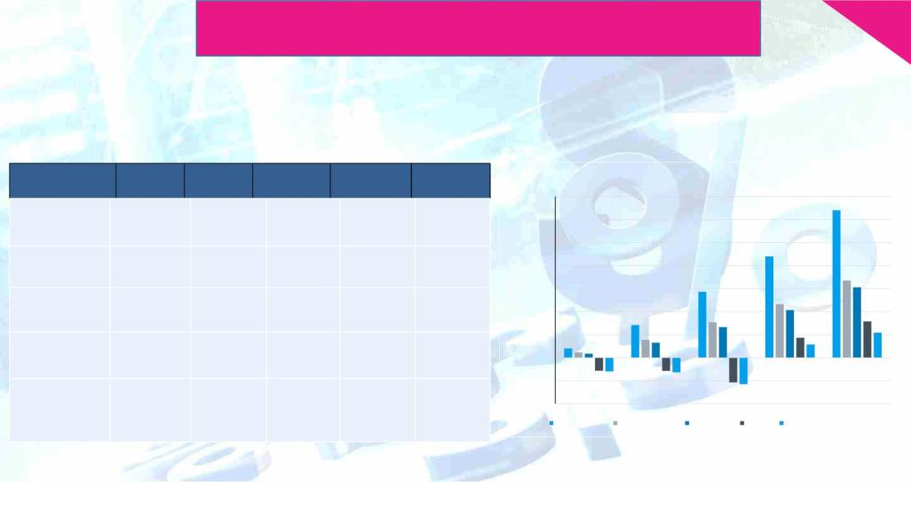
Financials – Projected Next Five Years
23
Projected Profit & Loss
Amount In INR
FY2026 FY2027
Particulars
FY2023 FY2024
FY2025
Welltopia P&L Projections
140,000,000
120,000,000
100,000,000
80,000,000
60,000,000
40,000,000
20,000,000
0
Total Revenue
80,83,221 2,83,66,668 5,73,43,383 8,79,19,635 12,81,68,900
45,51,776 1,54,36,445 3,08,14,486 4,65,53,565 6,70,00,379
Total Direct Cost
Gross Profit
35,31,445 1,29,30,223 2,65,28,897 4,13,66,070 6,11,68,521
(1,13,58,422) (1,15,31,166) (2,14,87,922) 1,74,15,334 3,14,48,947
EBITDA
FY 23
FY 24
FY 25
FY 26
FY 27
-20,000,000
-40,000,000
Net Profit after
Tax
(1,19,65,075) (1,27,25,027) (2,30,71,584) 1,15,54,444 2,18,36,653
Total Revenue
Total Direct Cost
Gross Profit
EBITDA
Net Profit after Tax

Slide 24

DCF Valuation
24
DISCOUNTED CASH FLOWS
Amounts in Rupees
Particulars
FY2023
FY2024
FY2025
FY2026
FY2027
Perpetuity
EBIT
(1,19,65,075)
-
(1,27,25,027)
(2,30,71,584)
1,58,93,320
3,00,36,662
3,22,77,397
88,11,729
2,34,65,668
15,17,641
2,49,83,309
Less: Tax
-
-
43,38,876
1,15,54,444
15,22,014
1,30,76,458
-
82,00,009
2,18,36,653
14,12,285
2,32,48,938
-
NOPAT
(1,19,65,075)
(1,27,25,027)
11,93,861
(2,30,71,584)
Add: Depreciation
6,06,653
(1,13,58,422)
41,20,795
15,83,662
(2,14,87,922)
16,65,500
Cash Flows from Operations
Capital Expenditure
(1,15,31,166)
33,31,000
1,28,16,890
4,08,000
Increase (Decrease) in Non Cash Working Capital
76,250
1,91,336
2,73,341
2,88,429
3,79,676
Free Cash Flows
Terminal Value
PV Factor
(1,55,55,467)
(1,50,53,502)
(2,34,26,763)
1,27,88,029
2,28,69,262
1,17,58,419
25,91,67,260
0.57
0.89
0.80
0.71
0.64
0.57
PV of Free Cash Flows
(1,38,89,182)
(1,20,01,202)
(1,66,76,047)
81,27,894
1,29,78,371
14,70,78,161
Valuation
PV of Forecast Period Value
PV of Terminal Value
April-22
(2,14,60,166)
14,70,78,161
12,56,17,994
-
Impact of Capex (in perpetuity) on Valuation
10% of revenue - 12.56 Crore - We have kept it at the highest
7.5% of revenue -16.56 Crore
Enterprise Value
5% of revenue -20.57 Crore
Less: Debt & Bank Borrowings
Equity Value
12,56,17,994

Slide 25

25
Valuation and The Ask
Business Valuation is estimated to be at very conservative
INR 12 Crore
The founder has already invested an amount of Rs.
3,000,000 in the company that has been used to set
up one healthcare center at Noida and develop the
Apps. An additional amount of Rs. 30 million (Rs.
three Crore) is sought from the investors to finance
the expansion plans of the company in terms of more
OPD centers and promotion of the Apps to achieve at
least a five lacs installation mark in next three years.
The amount to be raised from the investors for the
business will be used to fund the set up of five new
OPDs, promoting the Apps and to create a strong
brand “Welltopia” by the company.

Slide 26

26
Milestones to be Achieved
Welltopia Apps
Dec 2022: Apps
200,000
downloads :
June-Dec 2024
500,000
downloads: Jun
-Dec 2025
Launched and
promotion
started
Welltopia OPDs
Aug 2022: one
OPD
(established for
three years)
Dec 2023: three
OPDs (two
OPDs added)
Jun 2025: six
OPDs (three
more OPDs
added)

Slide 27

27
Exit Strategy
We will be applying one of the following strategies to
facilitate profitable exit for the investors from our business
venture –
Buy-back: Although using the ultra-conservative
approach for preparing Financial Model, we can estimate
that the company will generate excess cash flow, through
which the company will be able to buy back its share at
significant premium to pay the investors at the time of
exit.
Merger: Merging with a similar company or being bought
by a larger company is always a better option to exit. It is
a win-win situation when bordering companies have
complementary skills, and can save resources by
combining.
Listing on SME Exchange or BSE/NSE in next five to seven
years: there is strong demand and acceptance of the
healthcare company at Indian bourses, we expect to get
listed at a healthy P/Ex and thus create a handsome
wealth for our investors. – This will be the most probable
option to provide exit to the investors

Slide 28

Contact Info
Web: www.welltopia.pro
E: info@welltopia.pro / welltopia2018@gmail.com
WA: +91-83949 55932
Thank You

Slide 29

Appendix – Reduction in Carbon Footprint by Welltopia Apps
1. A car in India emits 100-120 grams of CO2 per KM of travel.
2. On an average a patient has to travel 15-20 KM (round trip) to visit a doctor’s OPD
3. So, our App saves ~2kg of CO2 emission per patient served
4. Assuming 10,000 patients utilize our app instead of going to a doctor’s OPD, our Apps save 20,000
KG of CO2 emission
5. It’s equivalent to planting about 1,000 Trees (a tree absorbs 10 to 40 kg of CO2 per year, on an
average 20 KG of CO2 per year)

